Slide 1

Graphic Era (Deemed to be University)
Department of Computer Science and Engineering
Mini Project Title:
URL SHORTENER USING DJANGO
Under the Mentorship of
Mr. Yuvraj Joshi
Assistant Professor
Submitted by:
Dhruv Goyal
Uni. Roll no. :2018789

Slide 2
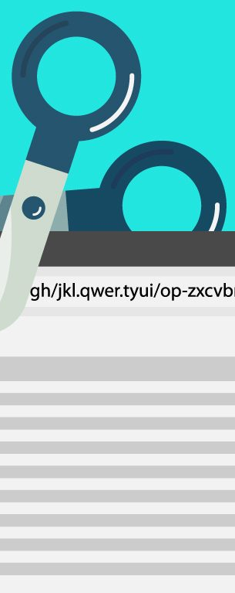
INTRODUCTION
URL shortening is a simple yet powerful tool that allows you to create shorter, more manageable links. Whether you're sharing a link on social media or sending it in an email, URL shortening can help make your content more accessible and easier to share.
The robust Django features, such as URL routing, models, views, and templates, will be utilized in the development of the URL shortener application. Long URLs can be entered by users, and the system will produce a special, abbreviated identification for each input. When consumers click on the shortened link, they will be sent to the original URL using this identity.

Slide 3
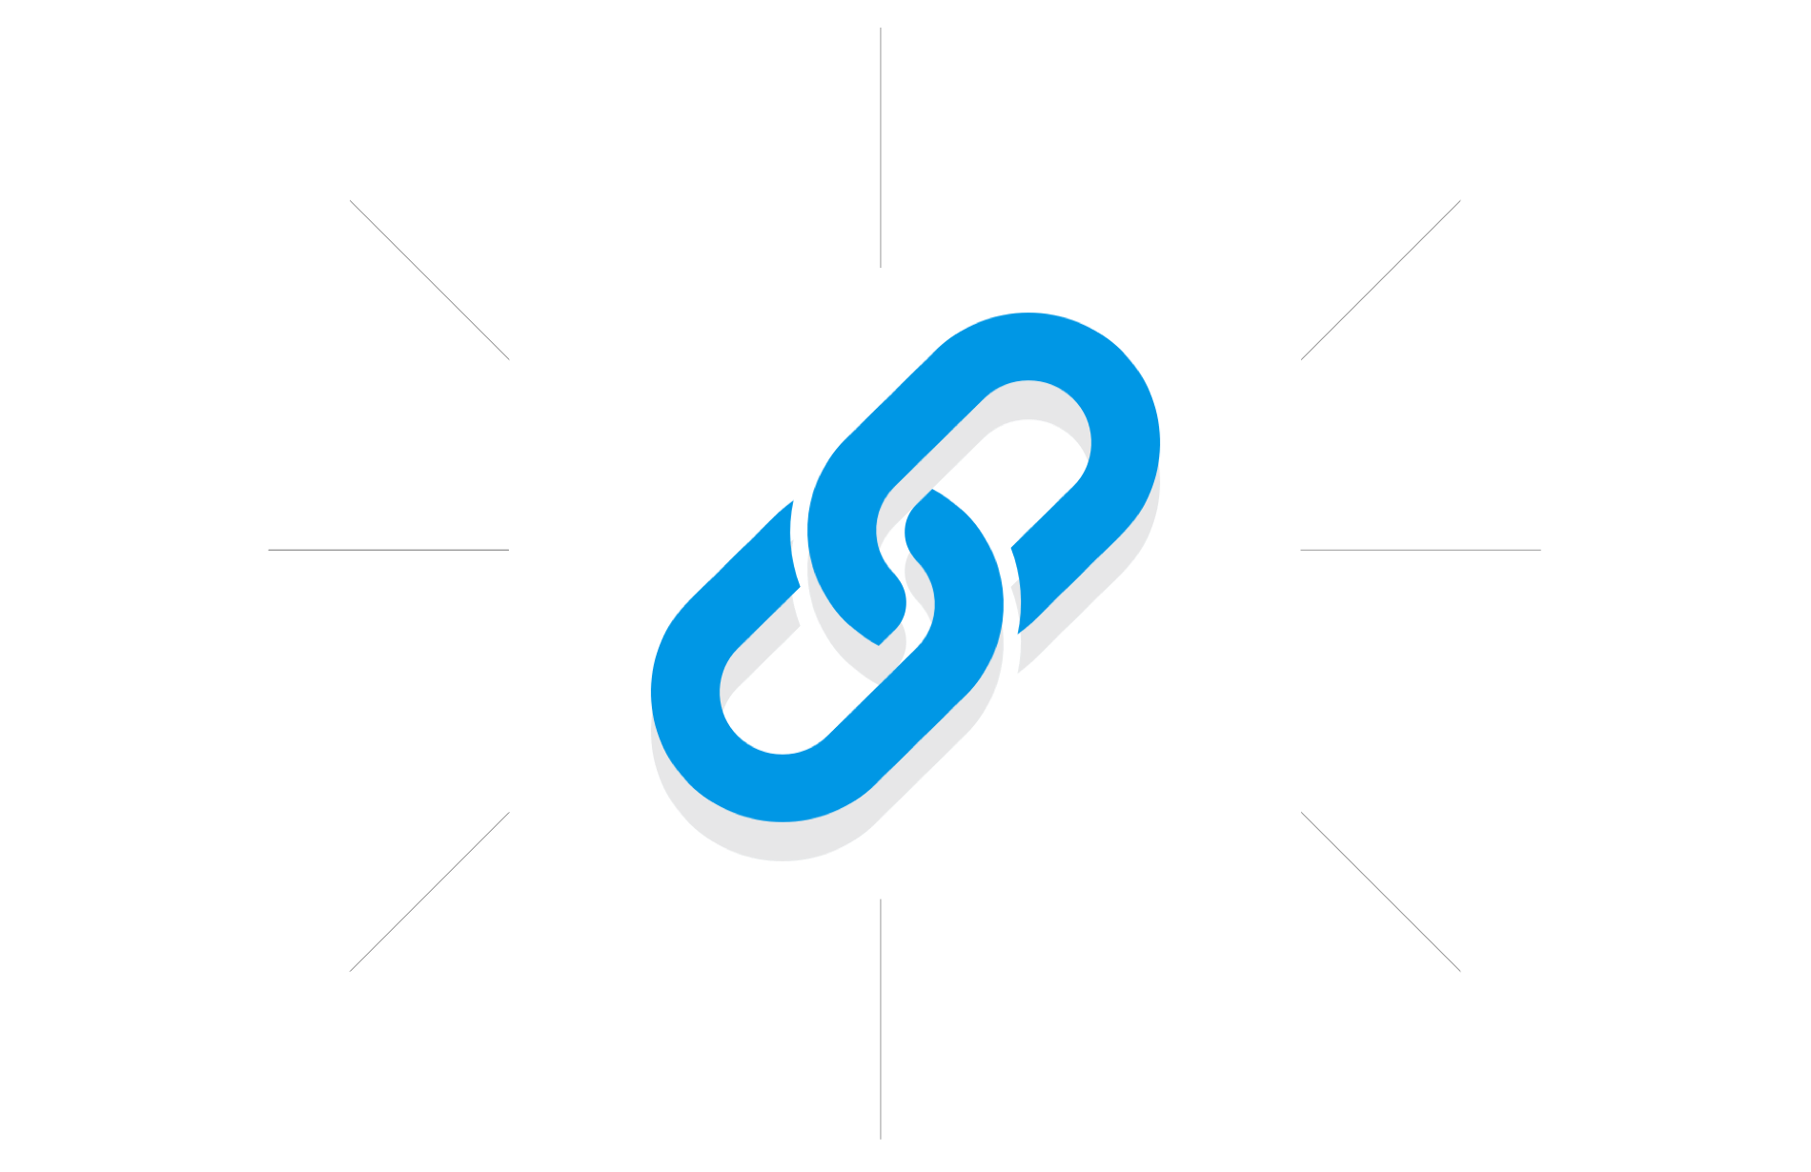
Problem Statement
In the digital age, long and complex URLs are ubiquitous on the internet, providing access to a vast array of information and resources. However, these lengthy URLs can be impractical and difficult to share effectively, especially on platforms with character limitations or in printed materials. This poses a challenge for users who wish to share URLs conveniently and memorably. The problem is further exacerbated by the need for space-efficient URLs for marketing campaigns, social media sharing, and mobile communication.

Slide 4
METHODOLOGY
Regarding this project Django is used along with HTML (Hypertext Markup Language) and
CSS (Cascading Style Sheets) for the front end. Regarding the database, we use SQLite
(to manage the data).
Creating Project Space
The command “Django-admin startproject name” is used to create a new Django project
with the specified name (name of project).
Creating Server
The “python manage.py runserver” command is used in Django projects to start the development server. This starts a lightweight web server that serves Django applications locally for testing and development purposes.

Slide 5
Creating URL routes
In Django, the urls.py file plays an important role in defining the routing and URL mapping for your web application.
It is used to map incoming URLs to specific functions or view classes, allowing the Django framework to determine how to handle different HTTP requests and generate appropriate responses.
Creating New Template
Templates are an essential component of the Django framework's templating engine.
To create dynamic HTML (or other forms of text-based content) that may be provided as
replies to user requests, Django uses templates.
Creating New App
An app, which stands for "application" in Django, is a modular part that has a
defined role inside a Django project.

Slide 6
Creating Database to store the URL
The virtual RDBMS we use to create databases in Django is called SQLite and in
order to achieve that, we must update the data in the "models.py" file.
Creating Admin to manage the database
A superuser account can be created in the Django admin interface using the management
command "python manage.py create superuser" in Django.
The Django admin interface offers a simple web-based interface for handling administrative
chores and managing the data for your application.
Finally Creating the Frontend
To create the frontend of our Project we have created a new Template and created the
file “index.html”, containing all the HTML and CSS of our Project’s Frontend.

Slide 7
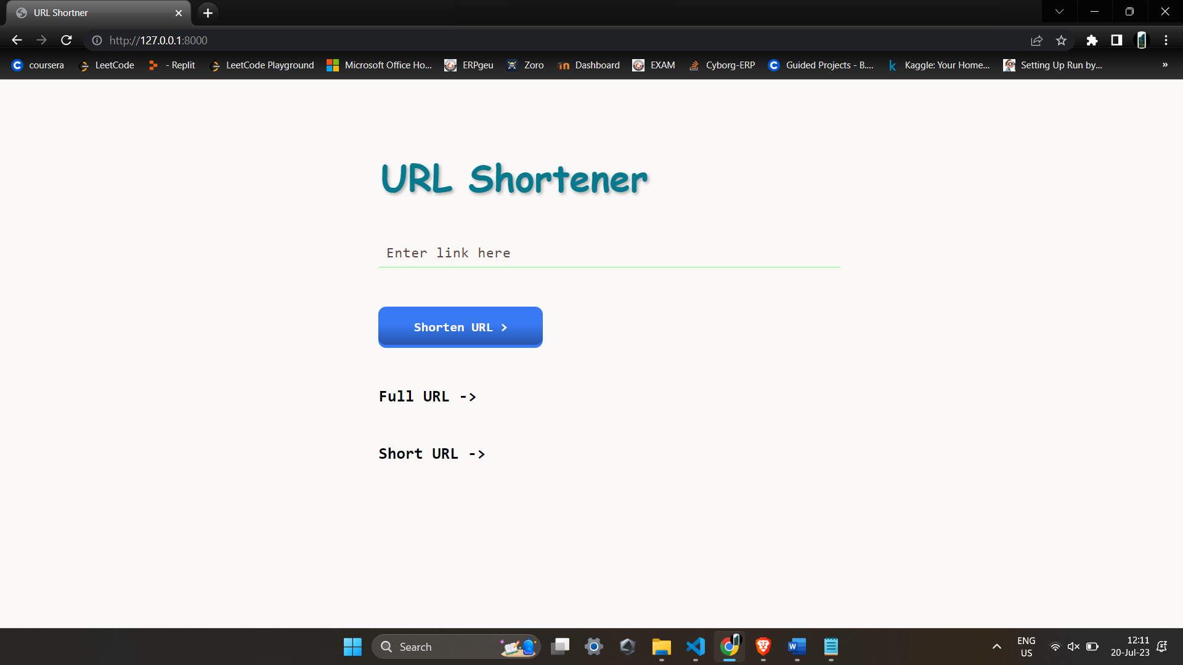
RESULTS
Main Interface
We used HTML and CSS to build the primary interface and did our best to keep it as simple as we could while yet giving it all the capabilities of a URL Shortener.

Slide 8
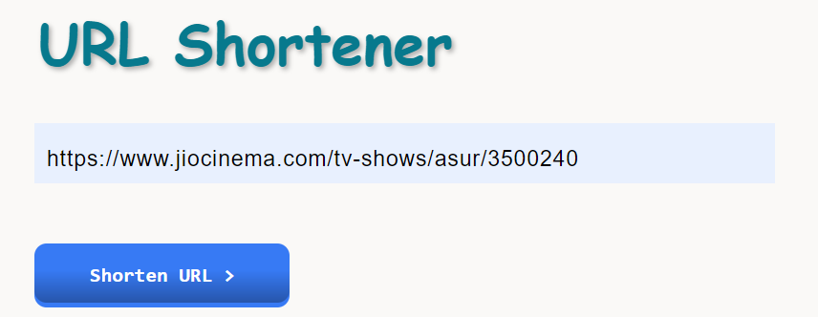
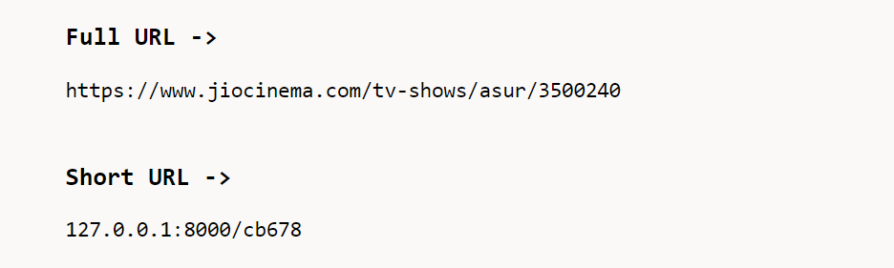
How does it work
First copy the link that you want to shorten and paste it into the URL Shortener,
Then hit the Shorten URL button and after this you will get the Shortened link,
Now copy the shortened link and paste it inside the browser and you will be redirected
to the required web page.

Slide 9
DISCUSSION
The use of Django to create the URL shortener turned out to be a worthwhile venture, providing a wealth of ideas and results that call for further debate. In this section, we'll discuss the main findings, talk about the difficulties we ran through, and consider how well the URL shortener program worked all around.
Efficiency
The reliability and adaptability of Django were essential to the accomplishment
of our URL shortener project. Because of the built-in functions of the framework,
Unique URL
A crucial component of our URL shortener solution was the selection of an original key
generation mechanism.
Scalability
exploring the integration of social media sharing functionalities and third-party API support will provide more comprehensive experience for users.

Slide 10
CONCLUSION
Finally, it can be said that creating a URL shortener with Django was a successful undertaking.
Users can easily share and access material because the software efficiently
shortens large URLs into shorter, easier-to-manage links.
We have learned a lot about working with Django, establishing URL routing, and
effectively managing database models as a result of this project.
FUTURE WORK
While the URL shortener application is functional and meets its primary objectives, there are several areas
for potential future improvement and expansion. Some ideas for future work include:
Custom Short URLs
Mobile App
User Authentication
Link Categorization
API Integration

Slide 11
Thank You

